Slide 1

Project 1
Gonçalo Carvalho

Slide 2
Project Overview
Analysis to the API-FOOTBALL from rapidapi.com
The idea behind this project is to answer the question:
Are the youngsters taking over the experienced in football?
Reason this can be useful for professional football workers:
Analyze different successful squads by their average age
Help to choose between an experience or youth player to built the squad
If possible, apply the conclusions into real life.

Slide 3
Project Overview
For this project, a few assumptions were made:
The analysis is only based on Premier League teams
Considering that an average player starts their professional career at 18 years old and finish at 35 years old, was defined as youngsters until 26 years old and experienced over 26 years old.
Premier League top 6 teams are Arsenal, Chelsea, Liverpool, Manchester City, Manchester United and Tottenham

Slide 4
Project Structure
The 1st analysis followed the next structure:
Get the league_id of Premier League
Get the standings of 2023 to understand who was the champion
Get the teams within the league_id
Get the players and their information within the teams
Get the average age of each team.

Slide 5
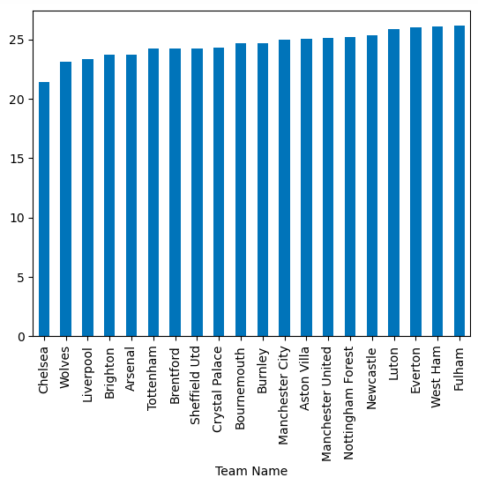
1st Analysis
In 2023, Manchester City was the champion.
Chelsea had the lowest average age squad while Fulham had the highest average age squad.
Manchester City had an average age squad lower than 26 years so it is possible to consider an young squad however there is no much to conclude here.
Let's dive deep on the analysis.

Slide 6
Diving Deep
The 2nd analysis followed the next structure:
To restrict the analysis from 20 teams, the goal for this 2nd analysis is to analyze the performance of the top 6 teams.
Get the standings of the past 10 years to understand who was the champion
Get the players and their information within the teams for those 10 years
Get the average age of each team for each year
If possible get the average age of starting 11 from each team in each year.

Slide 7
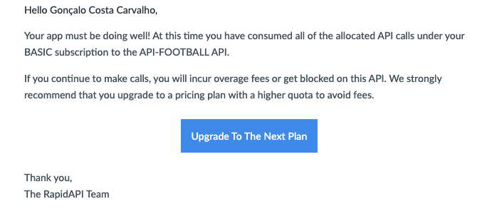
Diving Deep
Starting the 2nd analysis only the standings were possible to obtain.
A lot of errors happened:

Slide 8
Conclusions and future actions
Try web scraping next time
Have a better organization to get the results
Not insist on an incorrect way to do the analysis
Applying to the real life, one of the goals of this analysis was also to understand if success comes with time and experience. Unfortunately wasn’t possible to reach any conclusion.

Slide 9
Thank you
Gonçalo Carvalho

